Slide 1
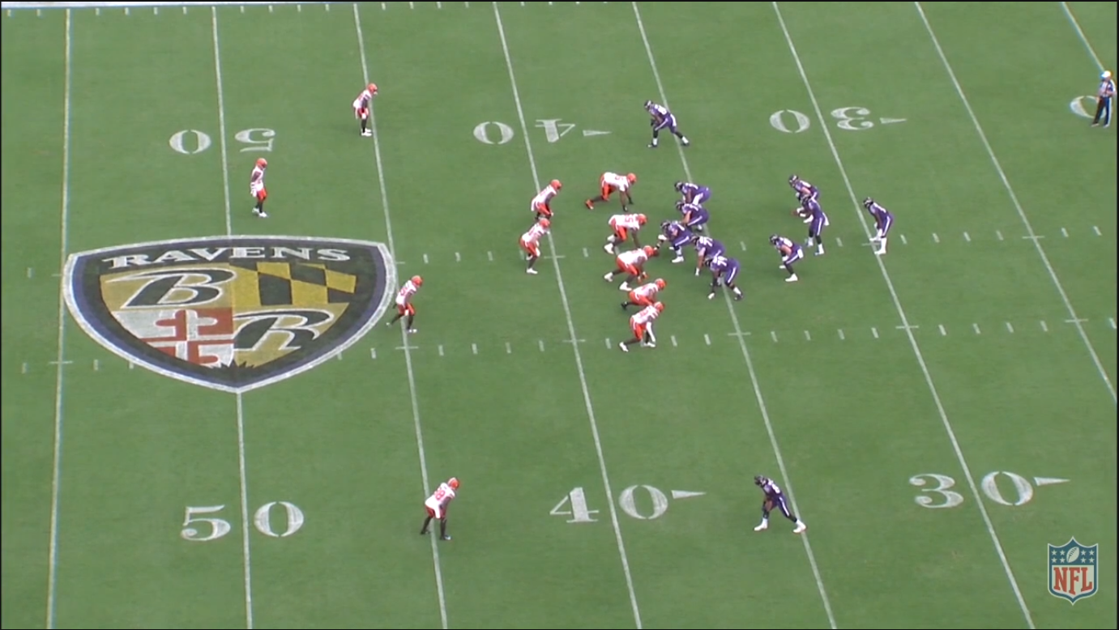
American Football Formation/Play: Relativity and Recognition
William Johanson

Slide 2
Problem Statement/Background
Provide a means to glean game critical data without manual labour.
Determine the field lines and identify the Line of Scrimmage (LOS).
Identify the offensive and defensive players.
Output the data in a means that the end user can begin critical analysis.

Slide 3
Solution/Algorithms
Field Lines/ LOS Detection:
Probabilistic Hough Line Transforms.
  Canny Edges.
  Gaussian blur.
  Moving Average Filter.
  Player Detection:
Colour Thresholding.
L*a*b* colour space conversion.
Morphology open/close
Adaptive thresholding.
Contouring.

Slide 4
Results, Limitations, Improvements and Comparisons
Improved line detection meant detection occurring throughout play clip.
First frame identification of LOS correct.
Players detected but requires improvement to create meaningful statistics from such detections.
Field logo and NFL logo watermark removal.
No trained data to map output to specific formations/plays.
Unable to utilize Pytesseract to detect field numbers to create relative position in output.
Basis for development to detailed dataset creation.

Slide 5
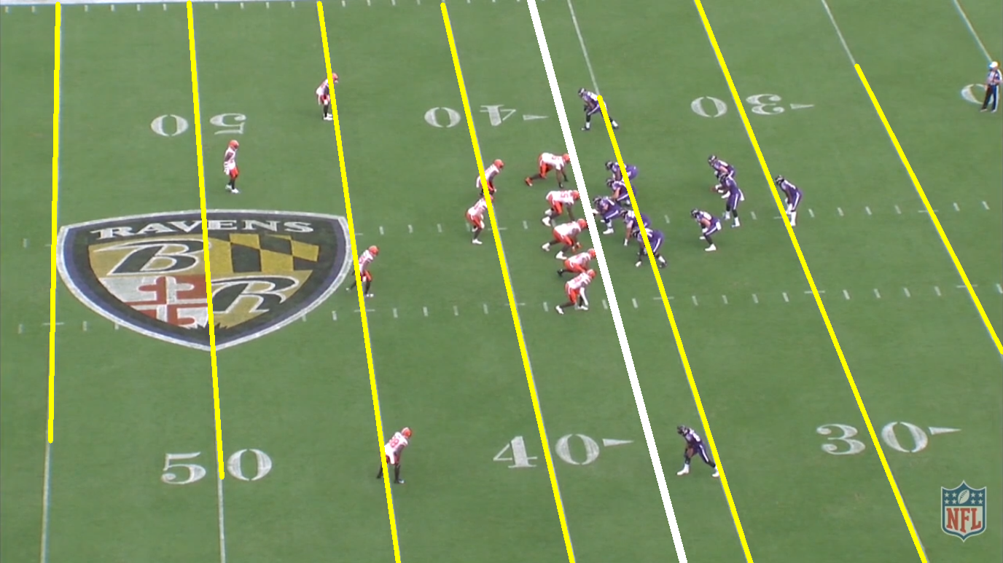

Slide 6
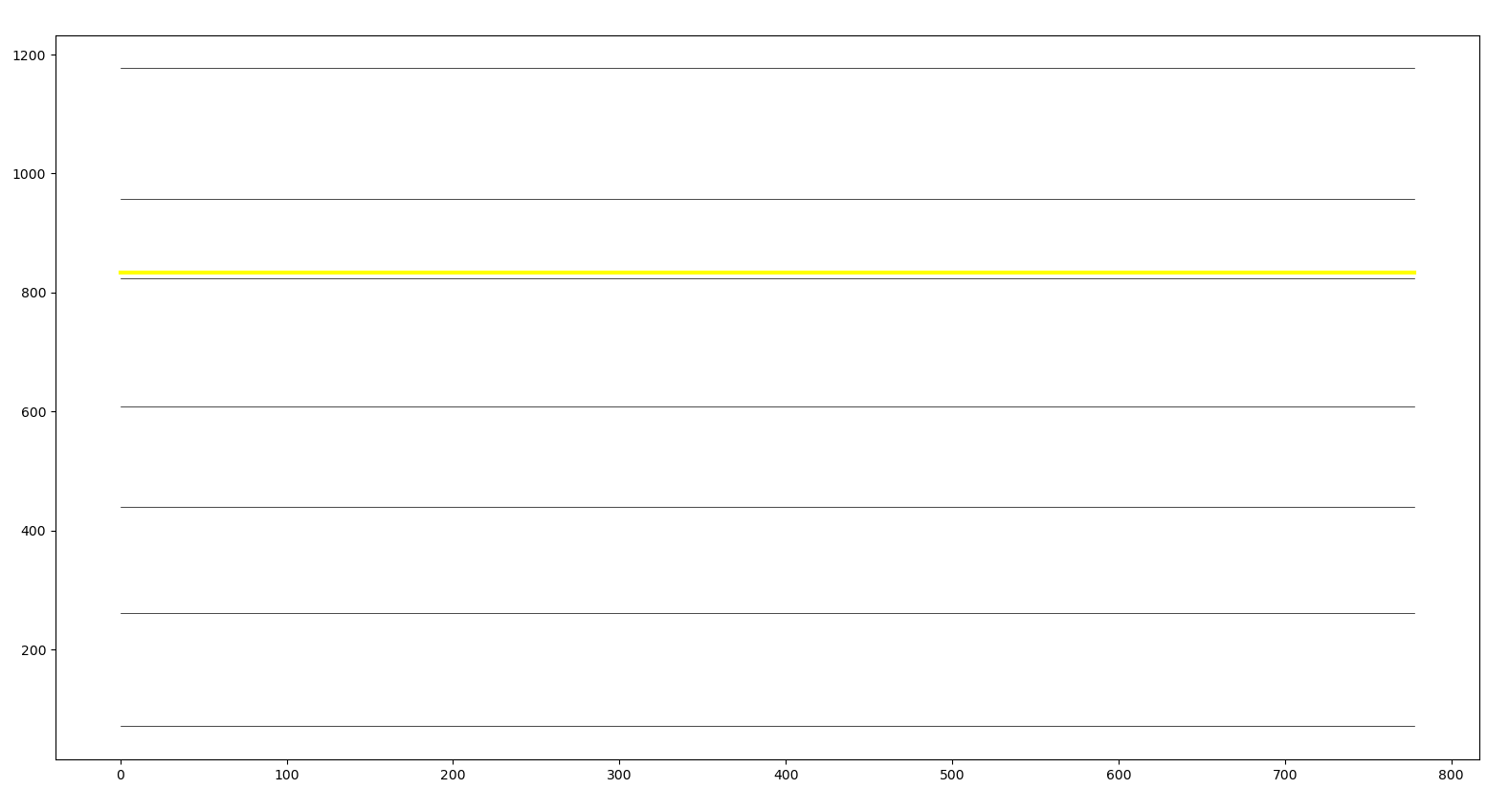

Slide 7
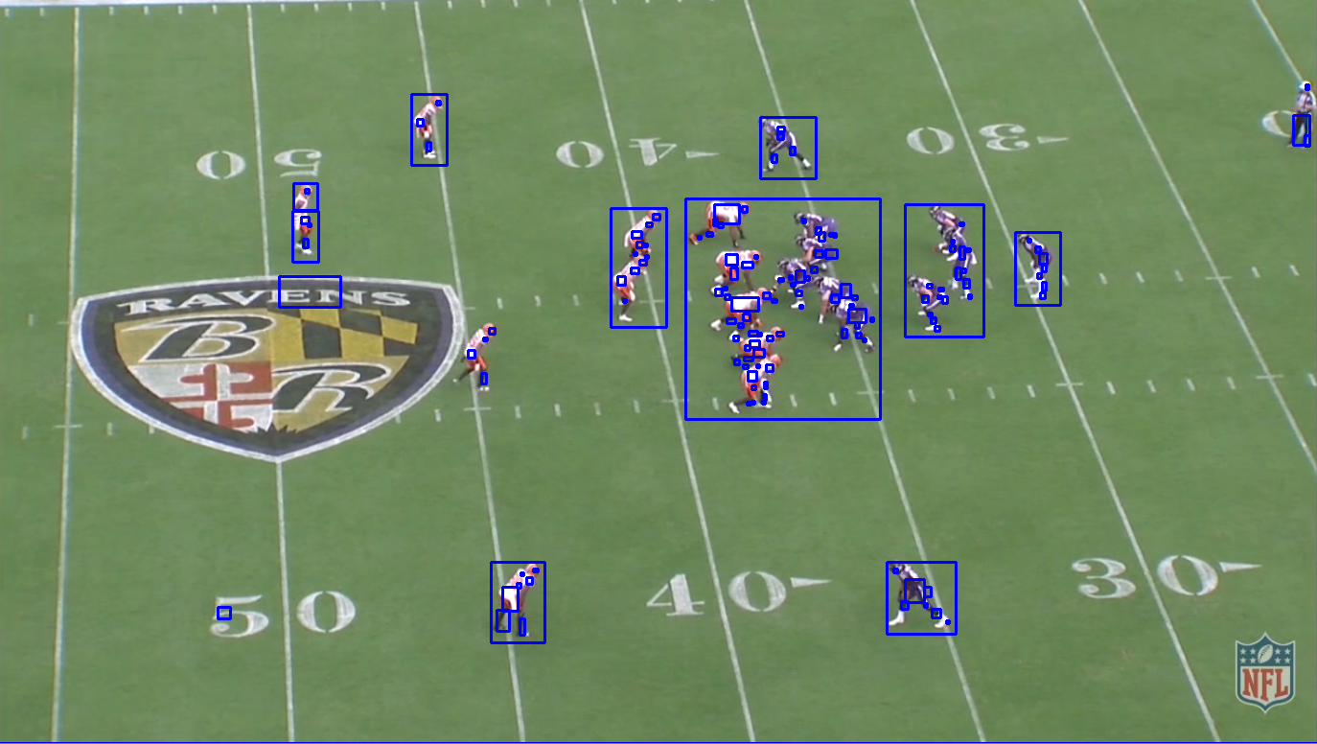

Slide 8
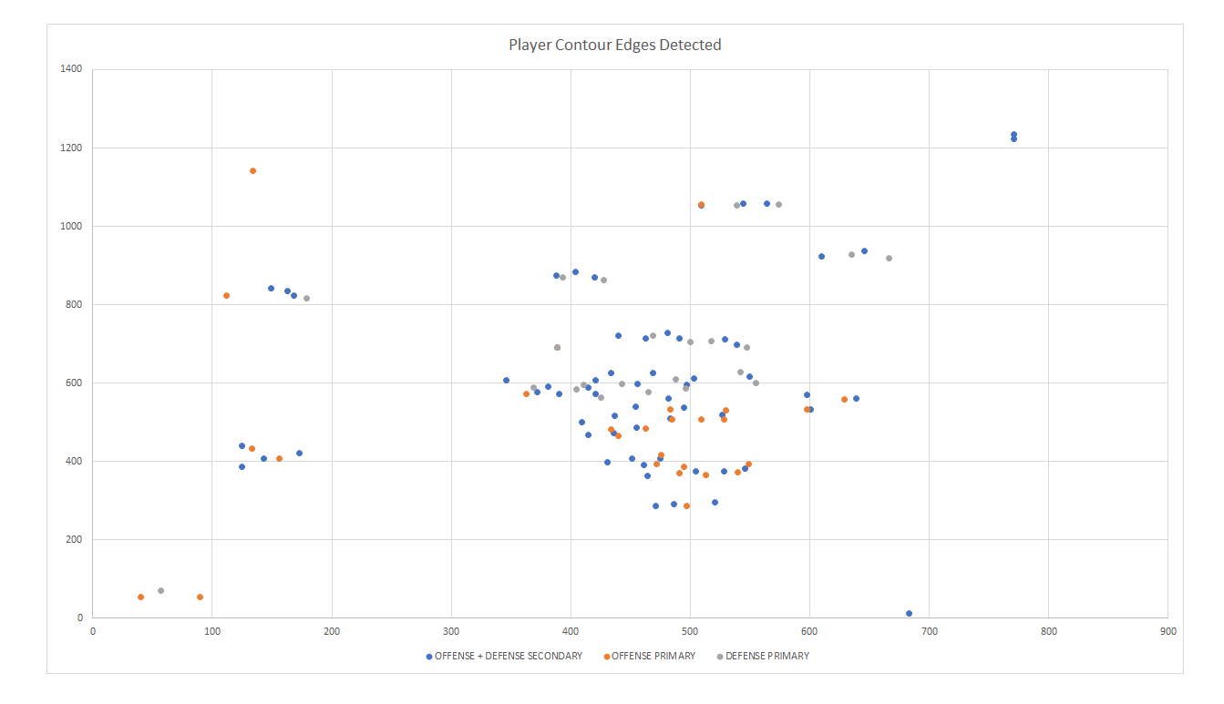

Slide 9
References
Pro Football Focus, https://www.pff.com/
Sentio Sports, https://www.sentiosports.com/
SportsLogiq, https://sportlogiq.com/en/about-us
Timothy E. Lee, “Automating NFL Film Study: Using Computer Vision to Analyze All-22 NFL Film,” pp. 1–9, Sourced https://cvgl.stanford.edu/teaching/cs231a_winter1415/prev/projects/LeeTimothy.pdf. Last accessed: 5/05/2020.
O. Ajmeri and A.Shah, “Using Computer Vision and Machine Learning to Automatically Classify NFL Game Film and Develop a Player Tracking System” MIT Sloan Sports Analytics Conference, 2018 pp. 1-9 Sourced http://www.sloansportsconference.com/wp-content/uploads/2018/02/2012.pdf. Last accessed: 5/05/2020
D. Cervone, A. D’Amour, L. Bornn and K. Goldsberry, “ Predicting Points and Valuing Decisions in Real Time with NBA Optical Tracking Data,” 8Th Annual MIT Sloan Sports Analytics Conference February 28 – March 1, 2014.
A. McQueen, J. Wiens, and J. Guttag, “Automatically Recognizing On-Ball Screens,” 8th Annual MIT Sloan Sports Analytics Conference, February 28 – March 1, 2014.
M. Di, D. Klabjan, L. Sha and P. Lucey, “Large-Scale Adversial Sports Play Retrieval with Learning to Rank,” ACM Transactions on Knowledge Discovery from Data, Vol. 12, No. 6, Article 69. Publication date: August 2018.
D. Kim, “Sobel Operator and Canny Edge Detector,” Fall 2013 pp. 1-10. Sourced: https://www.egr.msu.edu/classes/ece480/capstone/fall13/group04/docs/danapp.pdf Last accessed: 13/05/2020.
R.S. Stephens, “A Probabilistic Approach to the Hough Transform,” Sourced: http://www.bmva.org/bmvc/1990/bmvc-90-012.pdf Computing Devices Eastbourne Ltd, East Sussex. 1990, Last accessed: 13/05/2020.
W. Gurpinar-Morgan, D. Dinsdale, J. Gallagher, A. Cherukumudi and P. Lucey, “ You Cannot Do That Ben Stokes: Dynamically Predicting Shot Type in Cricket Using a Personalized Deep Neural Network,” 14th Annual MIT Sloan Sports Analytics Conference March 6-7, 2020.
M. Horton, “Learning Feature Representations from Football Tracking,” Sportlogiq, 14th Annual MIT Sloan Sports Analytics Conference March 6-7, 2020.
N. Johnson, “Extracting Player Tracking Data from Video Using Non-Stationary Cameras and a Combination of Computer Vision Techniques,” ESPN Analytics, 14th Annual MIT Sloan Sports Analytics Conference March 6-7, 2020.
R. Hartley and A. Zisserman, Multiple View Geometry in Computer Vision, Cambridge University Press, 2004.
R. Szeliski, Computer Vision: Algorithms and Applications, Springer, 2011.
M.T. Ahmed, M. N. Dailey, J.L. Landabaso and N. Herrero, “Robust Key Frame Extraction for 3D Reconstruction from Video Streams.

